Slide 1





Agricultural Raw materials Analysis
Student Details:
Name: Amuthan
NM Id:au2021502003
Madras Institute of technology, chennai

Slide 2

Agricultural raw material Analysis
Disclaimer
The content is curated from online/offline resources and used for educational purpose only

Slide 3
Agricultural raw material Analysis
Course Outline
Abstract
Problem Statement
Aims, Objective & Proposed System/Solution
System Deployment Approach
Model Development & Algorithm
Future Scope
Video of the Project
Conclusion
Reference

Slide 4

Agricultural raw material Analysis
Problem Statement
Increasing volatility in agricultural raw material prices poses significant challenges for stakeholders across the agricultural value chain. Farmers, traders, and policymakers require accurate and timely information to make informed decisions regarding production, marketing, and policy formulation.
This project aims to analyze historical price data, identify key factors influencing price fluctuations, develop predictive models, and provide actionable insights to enhance decision-making and mitigate risks in the agricultural sector.

Slide 5

Agricultural raw material Analysis
Abstract
In agriculture sector where farmers and agribusinesses have to make innumerable decisions every day and intricate complexities involves the various factors influencing them. Analyzing agricultural raw materials involves examining various aspects such as crop production, soil quality, climate conditions, and pest management strategies to optimize yield and quality.
This analysis provides valuable insights for farmers, researchers, and policymakers to make informed decisions regarding crop selection, resource allocation, and sustainability practices in agriculture.

Slide 6

Agricultural raw material Analysis
Aim and Objective
Aim: To analyze agricultural raw material prices and mitigate price volatility.

Slide 7

Agricultural raw material Analysis
Objective
Develop predictive models to forecast agricultural raw material prices accurately.
Provide decision support tools to stakeholders for informed decision-making regarding production, marketing, and resource allocation.

Slide 8

Agricultural raw material Analysis
Proposed Solution
The proposed solution is to develop a bot using Artificial Intelligence and machine learning method that can analyze and visualize real-time price of raw materials and previous data.
It will integrate data from various sources such as Individual Price of raw materials, price change percentage based upon year and month.
It will provide a comprehensive view of raw materials, prices, and changes in market price, enabling farmers and consumers to make informed decisions.
It will helps to analyse and understand the data easily using plot diagrams, graphs & bar graph.

Slide 9
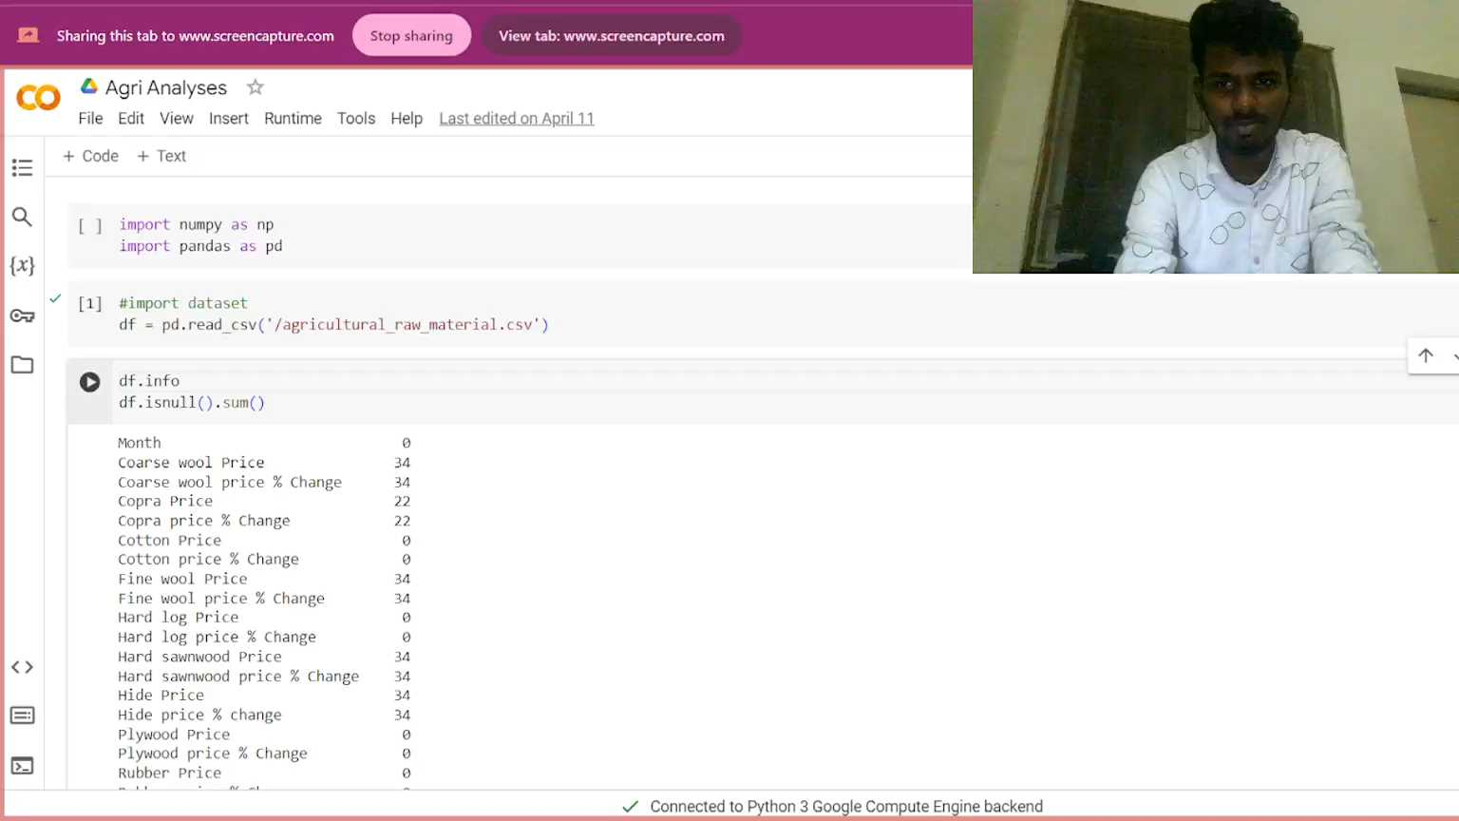
Agricultural raw material Analysis
Video of the Project

Slide 10

Agricultural raw material Analysis
Future Scope
The scope of this project encompasses a comprehensive approach to addressing agricultural raw material price volatility.
It involves collecting and analyzing data on various factors influencing prices, such as crop yields and market dynamics.
Through the development of predictive models and analytical tools, the project aims to forecast price trends and assess the impact of external factors.
Scenario analysis will be conducted to evaluate potential risks and develop contingency plans.

Slide 11

Agricultural raw material Analysis
Conclusion
In conclusion, this project offers valuable insights into the complex dynamics of agricultural raw material prices and the strategies to address price volatility in the sector.
Through comprehensive data analysis and modeling, key factors influencing price fluctuations have been identified, providing stakeholders with a deeper understanding of market dynamics
Decision support systems developed as part of the project offer real-time access to critical market information, empowering stakeholders to make informed decisions and adapt to changing market conditions.

Slide 12
Agricultural raw material Analysis
Reference
Project Github link, Ramar Bose , 2024
Project video recorded link (youtube/github), Ramar Bose , 2024
Project PPT & Report github link, Ramar Bose , 2024

Slide 13
Agricultural raw material Analysis
Thank you!

